Slide 1
Information Gain
Andrew W. Moore Professor
School of Computer Science Carnegie Mellon University
www.cs.cmu.edu/~awm awm@cs.cmu.edu
412-268-7599
Copyright © 2001, 2003, Andrew W. Moore
Note to other teachers and users of these slides. Andrew would be delighted if you found this source material useful in giving your own lectures. Feel free to use these slides verbatim, or to modify them to fit your own needs. PowerPoint originals are available. If you make use of a significant portion of these slides in your own lecture, please include this message, or the following link to the source repository of Andrew’s tutorials: http://www.cs.cmu.edu/~awm/tutorials .
Comments and corrections gratefully received.
Bits You are watching a set of independent random samples of X You see that X has four possible values
P(X=A) = 1/4 | P(X=B) = 1/4 | P(X=C) = 1/4 | P(X=D) = 1/4
So you might see: BAACBADCDADDDA… You transmit data over a binary serial link. You can encode each reading with two bits (e.g. A = 00, B = 01, C = 10, D = 11) 0100001001001110110011111100… Copyright © 2001, 2003, Andrew W. Moore Information Gain: Slide 2

Slide 2
Fewer Bits Someone tells you that the probabilities are not equal
P(X=A) = 1/2 | P(X=B) = 1/4 | P(X=C) = 1/8 | P(X=D) = 1/8
It’s possible… …to invent a coding for your transmission that only uses 1.75 bits on average per symbol. How? Copyright © 2001, 2003, Andrew W. Moore Information Gain: Slide 3
Fewer Bits Someone tells you that the probabilities are not equal
P(X=A) = 1/2 | P(X=B) = 1/4 | P(X=C) = 1/8 | P(X=D) = 1/8
It’s possible… …to invent a coding for your transmission that only uses 1.75 bits on average per symbol. How? (This is just one of several ways) Copyright © 2001, 2003, Andrew W. Moore Information Gain: Slide 4
A | 0
B | 10
C | 110
D | 111

Slide 3
Fewer Bits
Suppose there are three equally likely values…
P(X=A) = 1/3 | P(X=B) = 1/3 | P(X=C) = 1/3
Here’s a naïve coding, costing 2 bits per symbol
A | 00
B | 01
C | 10
Can you think of a coding that would need only 1.6 bits per symbol on average?
In theory, it can in fact be done with 1.58496 bits per symbol.
Copyright © 2001, 2003, Andrew W. Moore Information Gain: Slide 5
General Case Suppose X can have one of m values… V_{1,} V_{2, …} V_{m}
P(X=V₁) = p₁ | P(X=V₂) = p₂ | …. | P(X=V_{m}) = p_{m}
What’s the smallest possible number of bits, on average, per symbol, needed to transmit a stream of symbols drawn from X’s distribution? It’s H ( X ) = − p₁ log₂ p₁ − p₂ log₂ p₂ −K− p_{m} log₂ p_{m} m = −∑ p _{j} log₂ p _{j} j =1 H(X) = The entropy of X “High Entropy” means X is from a uniform (boring) distribution “Low Entropy” means X is from varied (peaks and valleys) distribution Copyright © 2001, 2003, Andrew W. Moore Information Gain: Slide 6

Slide 4
General Case Suppose X can have one of m values… V_{1,} V_{2, …} V_{m}
P(X=V₁) = p₁ | P(X=V₂) = p₂ | …. | P(X=V_{m}) = p_{m}
What’s the smallest possible number of ^{A histogram of the} , per f^{b}re^{it}q^{s}u,eºn^{n}cyªd^{v}is^{e}tr^{r}iªb^{g}ut^{e}ion of symbol, n_{A}ee_{h}d_{is}e_{to}d_{gr}t_{a}o_{m}tr_{o}a_{f} n_{th}s_{e}mit a stream voafluseysmofbXolwsodurldawhanvefrom X’s distribfuretiqoune?ncIyt’dsistribution of ^{many lows and one or} H ( X ) =^{va}−^{lu}p^{es} lºo^{f} g^{X w}p^{oul}−^{d b}p^{e f}l^{l}o^{at}g p − ^{two}−^{h}p^{ighs}log p 1 2 1 2 2 2 ^{K} m 2 m m = −∑ p _{j} log₂ p _{j} j =1 H(X) = The entropy of X “High Entropy” means X is from a uniform (boring) distribution “Low Entropy” means X is from varied (peaks and valleys) distribution Copyright © 2001, 2003, Andrew W. Moore Information Gain: Slide 7
General Case Suppose X can have one of m values… V_{1,} V_{2, …} V_{m}
P(X=V₁) = p₁ | P(X=V₂) = p₂ | …. | P(X=V_{m}) = p_{m}
What’s the smallest possible number of ^{A histogram of the} , per f^{b}re^{it}q^{s}u,eºn^{n}cyªd^{v}is^{e}tr^{r}iªb^{g}ut^{e}ion of symbol, n_{A}ee_{h}d_{is}e_{to}d_{gr}t_{a}o_{m}tr_{o}a_{f} n_{th}s_{e}mit a stream voafluseysmofbXolwsodurldawhanvefrom X’s distribfuretiqoune?ncIyt’dsistribution of ^{many lows and one or} H ( X ) =^{va}−^{lu}p^{es} lºo^{f} g^{X w}p^{oul}−^{d b}p^{e f}l^{l}o^{at}g p − ^{two}−^{h}p^{ighs}log p 1 2 1 2 2 2 ^{K} m 2 m m ⁼ ⁻∑ ^{p} .j.a^{lo}nd^{g}s2o^{p}thj e values _{..and so the values} ^{j =1} sampled from it would _{sampled from it would} be all over the place _{be more predictable} H(X) = The entropy of X “High Entropy” means X is from a uniform (boring) distribution “Low Entropy” means X is from varied (peaks and valleys) distribution Copyright © 2001, 2003, Andrew W. Moore Information Gain: Slide 8

Slide 5
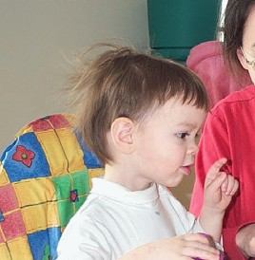
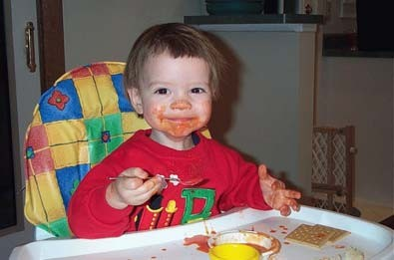
Entropy in a nut-shell
Low Entropy
High Entropy
Copyright © 2001, 2003, Andrew W. Moore
Information Gain: Slide 9
Entropy in a nut-shell
Low Entropy High Entropy
_{..the values (locations} ..the values (locations of
_{of soup) sampled} soup) unpredictable...
_{entirely from within} almost uniformly sampled
_{the soup bowl} throughout our dining room
Copyright © 2001, 2003, Andrew W. Moore Information Gain: Slide 10

Slide 6
Specific Conditional Entropy H(Y|X=v)
Suppose I’m trying to predict output Y and I have input X
X = College Major
Y = Likes “Gladiator”
Let’s assume this reflects the true probabilities
E.G. From this data we estimate
P(LikeG = Yes) = 0.5
P(Major = Math & LikeG = No) = 0.25
P(Major = Math) = 0.5
P(LikeG = Yes | Major = History) = 0
Note:
H(X) = 1.5
H(Y) = 1
X | Y
Math | Yes
History | No
CS | Yes
Math | No
Math | No
CS | Yes
History | No
Math | Yes
Copyright © 2001, 2003, Andrew W. Moore
Information Gain: Slide 11
Specific Conditional Entropy H(Y|X=v)
X = College Major
Y = Likes “Gladiator”
Definition of Specific Conditional Entropy:
H(Y |X=v) = The entropy of Y among only those records in which X has value v
X | Y
Math | Yes
History | No
CS | Yes
Math | No
Math | No
CS | Yes
History | No
Math | Yes
Copyright © 2001, 2003, Andrew W. Moore
Information Gain: Slide 12

Slide 7
Specific Conditional Entropy H(Y|X=v)
X = College Major
Y = Likes “Gladiator”
Definition of Specific Conditional Entropy:
H(Y |X=v) = The entropy of Y among only those records in which X has value v
Example:
H(Y|X=Math) = 1
H(Y|X=History) = 0
H(Y|X=CS) = 0
X | Y
Math | Yes
History | No
CS | Yes
Math | No
Math | No
CS | Yes
History | No
Math | Yes
Copyright © 2001, 2003, Andrew W. Moore
Information Gain: Slide 13
Conditional Entropy H(Y|X)
X = College Major
Y = Likes “Gladiator”
Definition of Conditional Entropy:
H(Y |X) = The average specific conditional entropy of Y
= if you choose a record at random what will be the conditional entropy of Y, conditioned on that row’s value of X
= Expected number of bits to transmit Y if both sides will know the value of X
= Σ_{j} Prob(X=v_{j}) H(Y | X = v_{j})
X | Y
Math | Yes
History | No
CS | Yes
Math | No
Math | No
CS | Yes
History | No
Math | Yes
Copyright © 2001, 2003, Andrew W. Moore
Information Gain: Slide 14

Slide 8
Conditional Entropy
X = College Major
Y = Likes “Gladiator”
Definition of Conditional Entropy:
H(Y|X) = The average conditional entropy of Y
= Σ_{j}Prob(X=v_{j}) H(Y | X = v_{j})
Example:
X | Y
Math | Yes
History | No
CS | Yes
Math | No
Math | No
CS | Yes
History | No
Math | Yes
v_{j} | Prob(X=v_{j}) | H(Y | X = v_{j})
Math | 0.5 | 1
History | 0.25 | 0
CS | 0.25 | 0
H(Y|X) = 0.5 * 1 + 0.25 * 0 + 0.25 * 0 = 0.5
Copyright © 2001, 2003, Andrew W. Moore
Information Gain: Slide 15
Information Gain
X = College Major
Y = Likes “Gladiator”
Definition of Information Gain:
IG(Y|X) = I must transmit Y. How many bits on average would it save me if both ends of the line knew X?
IG(Y|X) = H(Y) - H(Y | X)
X | Y
Math | Yes
History | No
CS | Yes
Math | No
Math | No
CS | Yes
History | No
Math | Yes
Example:
H(Y) = 1
H(Y|X) = 0.5
Thus IG(Y|X) = 1 – 0.5 = 0.5
Copyright © 2001, 2003, Andrew W. Moore
Information Gain: Slide 16

Slide 9
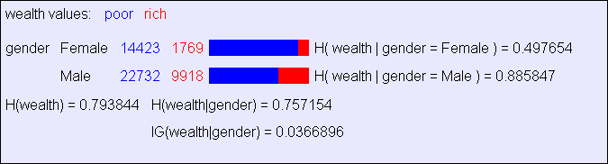
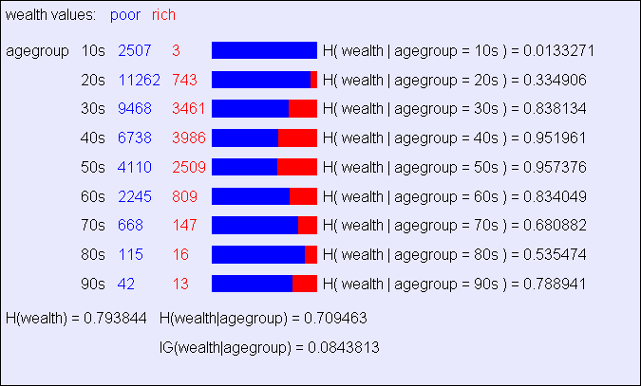
Information Gain Example
Copyright © 2001, 2003, Andrew W. Moore
Information Gain: Slide 17
Another example
Copyright © 2001, 2003, Andrew W. Moore
Information Gain: Slide 18

Slide 10
Relative Information Gain
X = College Major
Y = Likes “Gladiator”
Definition of Relative Information Gain:
RIG(Y|X) = I must transmit Y, what fraction of the bits on average would it save me if both ends of the line knew X?
RIG(Y|X) = H(Y) - H(Y | X) / H(Y)
X | Y
Math | Yes
History | No
CS | Yes
Math | No
Math | No
CS | Yes
History | No
Math | Yes
Example:
H(Y|X) = 0.5
H(Y) = 1
Thus IG(Y|X) = (1 – 0.5)/1 = 0.5
Information Gain: Slide 19
Copyright © 2001, 2003, Andrew W. Moore
What is Information Gain used for?
Suppose you are trying to predict whether someone is going live past 80 years. From historical data you might find…
•IG(LongLife | HairColor) = 0.01
•IG(LongLife | Smoker) = 0.2
•IG(LongLife | Gender) = 0.25
•IG(LongLife | LastDigitOfSSN) = 0.00001
IG tells you how interesting a 2-d contingency table is going to be.
Copyright © 2001, 2003, Andrew W. Moore Information Gain: Slide 20

